Slide 1
CSE 451: Operating Systems
Spring 2010
Module 4: Processes
John Zahorjan
zahorjan@cs.washington.edu
Allen Center 534
Notes:
1

Slide 2
Process management
This module begins a series of topics on processes, threads, and synchronization
  this is the most important part of the class
  there definitely will be several questions on these topics on the midterm
Today: processes and process management
  What is a “process”?
  What's the process namespace?
  How are processes represented inside the OS?
  The execution states of a process?
  How are they created?
  Making Creation Fast(er)
  Shells
  An example of process-process communication: signals

Slide 3
1. What is a process?
The process is the OS’s abstraction for execution
  A process is a program in execution
It's the OS-provided higher level abstraction for the hardware CPU and main memory resources
  E.g., notions of real time are simplified to sequential execution of successive instructions
The simplest (classic) case is the sequential process
  An address space (abstraction of memory)
  A single thread (abstraction of the CPU)
A sequential process is:
  the unit of execution
  the unit of scheduling
  the dynamic (active) execution context
    compared with program: static, just a bunch of bytes
thread
address space

Slide 4
What’s in a process?
A process consists of (at least):
  an address space, containing
    the code (instructions) for the running program
    the data for the running program
  thread state, consisting of:
    the program counter (PC), indicating the next instruction
    the stack pointer register (implying the stack it points to)
    Other general purpose register values
  a set of OS resources
    open files, network connections, sound channels, …
  other process metadata
    e.g., signal handlers
In other words, it’s all the stuff you need to run the program
  or to re-start it, if it’s interrupted at some point

Slide 5
Reminder from CSE 378: A process’s address space (idealized)
0xFFFFFFFF
stack
(dynamic allocated mem)
SP
address space
heap
(dynamic allocated mem)
static data
(data segment)
code
(text segment)
PC
0x00000000

Slide 6
2. The process namespace
(Like most everything, the particulars on the particular OS)
The name for a process is called a process ID (PID)
  An integer
The PID namespace is global to the system
  Only one process at a time has a particular PID
Operations that create processes return a PID
  e.g., fork(), clone(), exec()
Operations on processes take PIDs as an argument
  e.g., kill(), wait(), nice()

Slide 7
3. Processes in the OS
The kernel maintains a data structure to keep track of process state
  Called the process control block (PCB)
OS keeps all of a process’s hardware execution state in the PCB when the process isn’t running
  PC, SP, registers, etc.
  when a process is unscheduled, the state is transferred out of the hardware into the PCB
  (when a process is running, its state is spread between the PCB and the CPU)
Note: It’s natural to think that there must be some esoteric techniques being used
  fancy data structures that’d you’d never think of yourself
Wrong! It’s pretty much just what you’d think of!

Slide 8
The PCB
The PCB is a data structure with many, many fields:
  process ID (PID)
  parent process ID
  execution state
  program counter, stack pointer, registers
  address space info
  user id (uid)
  group id (gid)
  scheduling priority
  accounting info
  pointers for use in state queues
In Linux:
  defined in task_struct (include/linux/sched.h)
  over 95 fields!!!

Slide 9
PCBs and hardware state
When a process is running, its hardware state is loaded on a CPU
  PC, SP, registers
  CPU contains current values
When a process is transitioned to the waiting state, the OS saves the register values in the PCB
  when the OS returns the process to the running state, it loads the hardware registers from the values in that process’s PCB
The act of switching a CPU from one process to another is called a context switch
  timesharing systems may do 100s or 1000s of switches/sec.
  takes about 5 microseconds on today’s hardware
Choosing which process to run next is called scheduling

Slide 10
This is (a simplification of) what each of those PCBs looks like inside!
Process ID
Pointer to parent
List of children
Process state
Pointer to address space descriptor
Program counter stack pointer (all) register values
uid (user id) gid (group id) euid (effective user id)
Open file list
Scheduling priority
Accounting info
Pointers for state queues
Exit (“return”) code value

Slide 11
4. Process execution states
Each process has an execution state, which indicates what it is currently doing
  ready: waiting to be assigned to a CPU
    could run, but another process has the CPU
  running: executing on a CPU
    is the process that currently controls the CPU
    pop quiz: how many processes can be running simultaneously?
  Waiting (aka “blocked”): waiting for an event, e.g., I/O completion
    cannot make progress until event happens
As a process executes, it moves from state to state
  UNIX: run ps, STAT column shows current state
  which state is a process in most of the time?

Slide 12
States of a process (slightly simplified)
running
dispatch / schedule
interrupt (unschedule)
ready
exception (I/O, page fault, etc.)
interrupt
(I/O complete)
blocked

Slide 13
State queues
The OS maintains a collection of queues that represent the state of all processes in the system
  typically one queue for each state
    e.g., ready, waiting, …
  each PCB is queued onto a state queue according to the current state of the process it represents
  as a process changes state, its PCB is unlinked from one queue, and linked onto another
Once again, this is just as straightforward as it sounds! The PCBs are moved among queues, which are represented as linked lists. There is no magic!

Slide 14
State queues
These are PCBs!
Ready queue header
head ptr
firefox (1365)
emacs (948)
ls (1470)
tail ptr
Wait queue header
head ptr
cat (1468)
firefox (1207)
tail ptr
There may be many wait queues, one for each type of wait (particular device, timer, message, …)

Slide 15
PCBs and state queues
PCBs are data structures
  dynamically allocated inside OS memory
When a process is created:
  OS allocates a PCB for it
  OS initializes PCB
  OS puts PCB on the correct queue
As a process computes:
  OS moves its PCB from queue to queue
When a process is terminated:
  PCB may hang around for a while (exit code…)
    What is the process state?
  eventually, OS deallocates its PCB

Slide 16
5. Process creation
New processes are created by existing processes
  creator is called the parent
  created process is called the child
    UNIX: do ps, look for PPID field
  what creates the first process, and when?

Slide 17
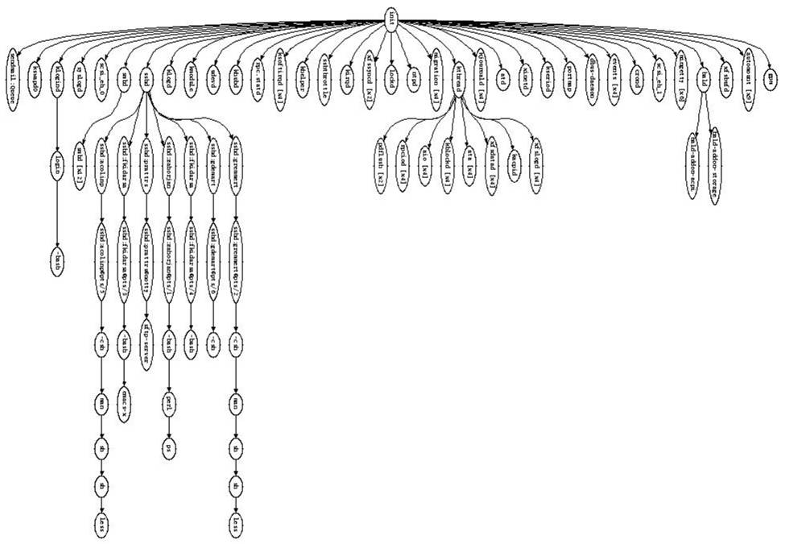

Slide 18
Process Creation Semantics
(Depending on the OS) child processes inherit certain attributes of the parent
Examples:
  pid/gid: implies authorization of child
  Open file table: implies stdin/stdout/stderr
  Environment variables
  … other metadata
  On some systems, resource allocation to parent may be divided among children
    Hierarchical resource allocation limits impact of your activity on mine

Slide 19
UNIX process creation details
UNIX process creation through fork() system call
  creates and initializes a new PCB
  creates a new address space
  initializes new address space with a copy of the entire contents of the address space of the parent
  initializes kernel resources of new process with resources of parent (e.g., open files)
  places new PCB on the ready queue
the fork() system call “returns twice”
  once into the parent, and once into the child
  returns the child’s PID to the parent
  returns 0 to the child
fork() = “clone me”
(We'll see why in a minute...)

Slide 20
testparent – use of fork( )
#include <sys/types.h>
#include <unistd.h>
#include <stdio.h>
int main(int argc, char **argv)
{
char *name = argv[0];
int pid = fork();
if (pid == 0) {
printf(“Child of %s is %d\n”, name, pid);
return 0;
} else {
printf(“My child is %d\n”, pid);
return 0;
}
}

Slide 21
testparent output
spinlock% gcc -o testparent testparent.c
spinlock% ./testparent
My child is 486
Child of testparent is 0
spinlock% ./testparent
Child of testparent is 0
My child is 571

Slide 22
fork() … exec()
Q: So how do we start a new program, instead of just forking the old program?
  A: first fork, then exec
int exec(char * prog, char * argv[])
  (actually, there are many flavors of exec)
  stops the current process
  loads program ‘prog’ into the address space
    i.e., overwrites existing process image
  initializes hardware context, args for new program
  places PCB onto ready queue
  note: does not create a new process!
To run a new program:
  fork()
  Child process does an exec()
  (parent either waits for child to complete, or not)

Slide 23
6. Making Creation Fast(er)
The semantics of fork() say the child's address space is a copy of the parent's
Implementing fork() that way is slow:
  Have to allocate physical memory for the new address space
  Have to copy parent's address space contents into child's address space
  Have to set up child's page tables to map new address space
We can speed this up...

Slide 24
Method 1: vfork()
vfork() is the older of the two approaches talked about here
It's (once again) an instance of changing the problem definition into something we can implement efficiently
Instead of “child address space is a copy of parent's,” the semantics are “child address space is the parent's”
  With a “promise” that the child won't modify the address space before doing an exec()
    This is unenforced. You use vfork() at your own peril.
  When exec() is called, a new address space is created, new page tables set up for it, and it's loaded with the new executable
  This saves the wasted effort of duplicating the parent's address space (setting up page tables and copying contents) when the child is just going to exec() anyway (which is common)

Slide 25
Method 2: copy-on-write
This approach retains the original semantics, but copies “only what is necessary,” rather than the entire address space
On fork():
  Create a new address space
  Initialize its page tables to the same mappings as the parent's (i.e., they both point to the same physical memory)
    No copying of address space contents have occurred to this point
  Set both parent and child page tables to make all pages read-only
  If either the parent or child writes to memory, a protection fault occurs
  When the fault occurs:
    Allocate a new physical frame for the child, and point its page table entry at it
    Copy the current contents of the parent address space to that frame
    Mark the entries in both the parent's and child's address space writable for that page
    Restart the process doing the write, re-executing the write instruction
The result: only pages modified by the parent or child ever end up being copied

Slide 26
7. UNIX shells
$ ./myprog
int main(int argc, char **argv)
{
while (1) {
printf(“$ “);
char *cmd = get_next_command();
int pid = fork();
if (pid == 0) {
exec(cmd);
panic(“exec failed!”);
} else {
wait(pid);
}
}
}

Slide 27
Input/Output Redirection
$ ./myprog <input.txt >output.txt # UNIX
  each process has an open file table
  by (universal) convention:
    0: stdin
    1: stdout
    2: stderr
  a child process inherits the parent’s open file table
  Redirection: open files before executing child process code

Slide 28
UNIX shells: input/output redirection
$ foo myFile.txt <input.txt >output.txt
int main(int argc, char **argv)
{
while (1) {
printf(“$ “);
char *cmd = get_next_command();
int pid = fork();
if (pid == 0) {
manipulate stdin/stdout/stderr
exec(cmd);
panic(“exec failed!”);
} else {
wait(pid);
}
}
}

Slide 29
More…
Note that redirection is completely transparent to the child process
What about
  $ ./myprog >>output.txt
  $ ./myprog >output.txt 2>&1
  $ ./myprog | less
  $ ./myprog &

Slide 30
8. Process-process communcation via signals
Processes can register event handlers
  Feels a lot like event handlers in Java, which...
  Feel sort of like catch blocks in Java programs
When the event occurs, process asynchronous jumps to event handler routine
Used to catch exceptions
Also used for process-process communcation:
  a process can trigger an event in another one using signal

Slide 31
Signals
Signal Value Action Comment
------------------------------------------------------------------------
SIGHUP 1 Term Hangup detected on controlling terminal
or death of controlling process
SIGINT 2 Term Interrupt from keyboard
SIGQUIT 3 Core Quit from keyboard
SIGILL 4 Core Illegal Instruction
SIGABRT 6 Core Abort signal from abort(3)
SIGFPE 8 Core Floating point exception
SIGKILL 9 Term Kill signal
SIGSEGV 11 Core Invalid memory reference
SIGPIPE 13 Term Broken pipe: write to pipe with no readers
SIGALRM 14 Term Timer signal from alarm(2)
SIGTERM 15 Term Termination signal
SIGUSR1 30,10,16 Term User-defined signal 1
SIGUSR2 31,12,17 Term User-defined signal 2
SIGCHLD 20,17,18 Ign Child stopped or terminated
SIGCONT 19,18,25 Continue if stopped
SIGSTOP 17,19,23 Stop Stop process
SIGTSTP 18,20,24 Stop Stop typed at tty
SIGTTIN 21,21,26 Stop tty input for background process
SIGTTOU 22,22,27 Stop tty output for background process

Slide 32
Example Use
You're implementing Apache, a web server
Apache reads a configuration file when it is launched
  Controls things like what the root directory of the web files is, what permissions there are on pieces of it, etc.
Suppose you want to change the configuration while Apache is running
  If you restart the currently running Apache, you drop some unknown number of user connections
Solution: send the running Apache process a signal
  It has registered an signal handler that gracefully re-reads the configuration file

